Slide 1
CS 188-2 Final Review
Albert Zhao
12/6/2019

Slide 2
Final Exam
Final exam is cumulative, covering both topics before and after midterm
More emphasis on topics after midterm
These slides focus on topics covered after the midterm
For topics before midterm, check out the midterm review slides

Slide 3
Problem Statement: Stitching images together
Multiple cameras taking pictures, note timestamp and stream them together
If multiple cameras not feasible, Wide Angle is an option
Issues:
Not 360 degree
Distortion in spatial curvature, aberration
Panorama!
Say we capture an indoor scene by sliding the camera and taking picture (translation and no rotation)
How to concatenate?
SIFT to find a seam?
Distortion!
Face taken from multiple viewpoints and stitched using SIFT - distortion is bad

Slide 4
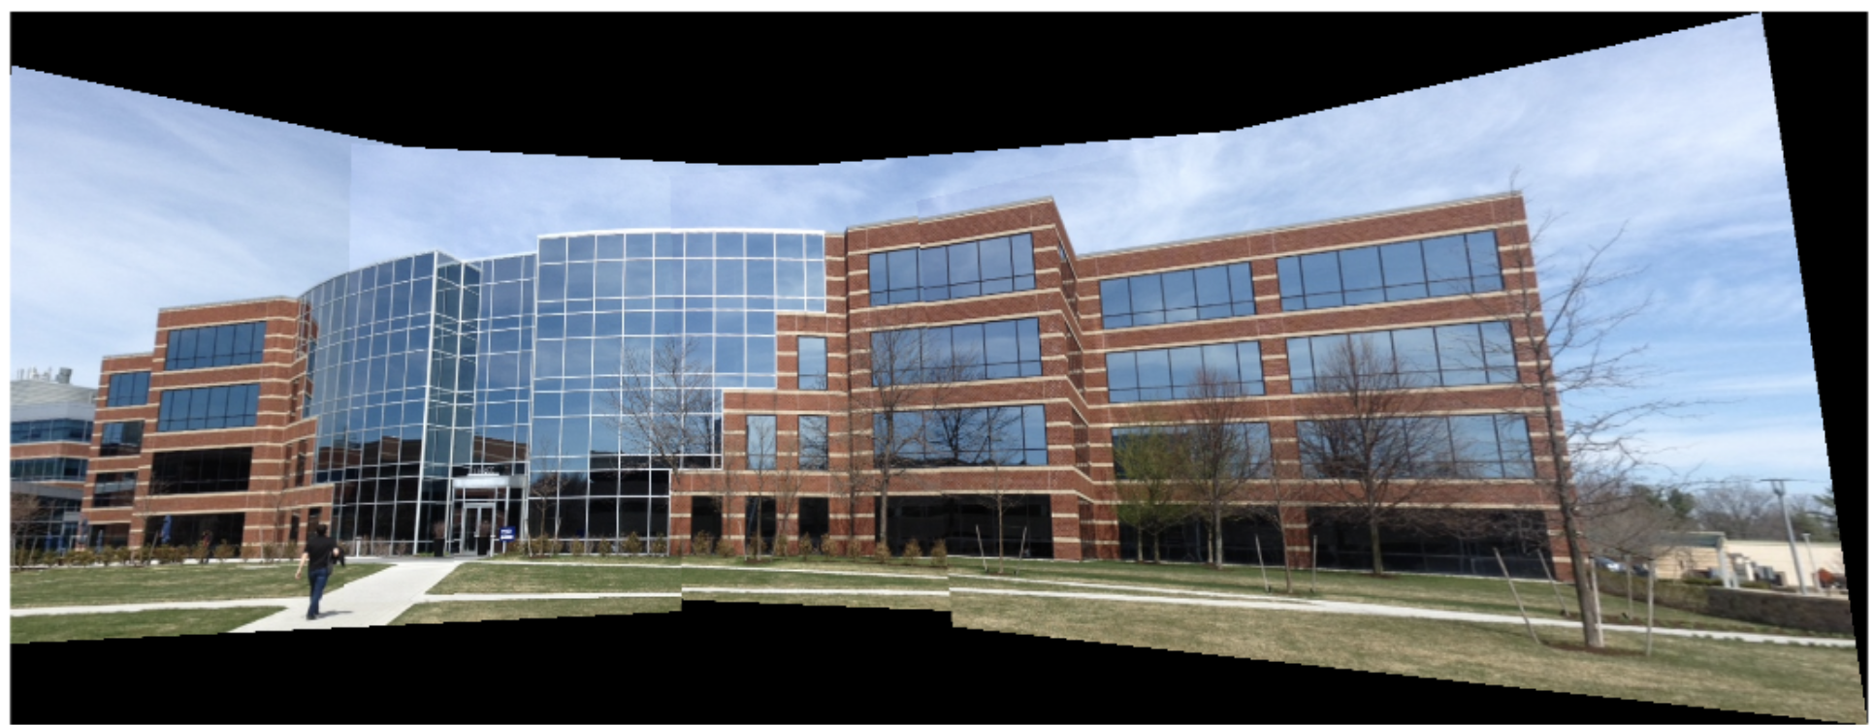
Intro to Homography
Includes transformation, affine, perspective, skew (subsumes everything)
Motivation for Homography: Lines need not map to lines and sometimes we want curvature to be accounted for (for instance, while making a panorama)

Slide 5
Why Homographies?
Linear transformations can represent transformations like rotations and scaling, but not translations
Affine transformations can represent translations and in fact, are linear transformations + a translation
But for applications like warping between camera views, affine transformations are insufficient
Why? We don’t necessarily want lines to map to lines because we want to take into account curvature and camera distortions
More theoretically, we want to map from 2D projective space to 2D projective space; affine transformations are insufficient for this

Slide 6
Assumptions to perform Homography
Only capture scene with camera rotation
Planar image or relative depth variation is small

Slide 7
Applications for Homography

Slide 8
Warping
Recall in class we discussed the corridors example. Trying to recreate a different view of the corridor, given the view from the top.
Possible to map one plane to another (using homography)
Note: we are not adding any new information; we’re reorganizing the image to make it look like it was taken from a different angle.
Industry applications plentiful : Hollywood movies, Mobileye etc.

Slide 9
Rectification
Image rectification is a transformation process used to project images onto a common image plane.
Given images from an arbitrary scene (from different viewpoints), we rectify them to a common camera space (warp to a synthetic camera space that is common)
Usually, we don’t take one and warp to another - we warp both into a common space (again, using homography)
Recall from lecture - street art, patterns in art (paintings)

Slide 10
Motivation for rectification
Say we want to know where a painting from the 1600’s was painted. Our brain can recognize patterns and ‘correct’ it to retrieve a rectified version. How to achieve this in CV?
Use bias/ prior knowledge to rotate the image (maybe based on our knowledge of what in the image is planar) to get what we expect/the extrinsics
So, homography helps us achieve a ‘rectified’ image which we then reconstruct base

Slide 11
Issue with this:
Human intervention dependant.
Imagine a car trying to capture the real time traffic view - cannot afford human intervention!
Need to pick a camera space ahead of time
Hence, need a machine to do automate this.
Motivation for RANSAC and SIFT.

Slide 12
Applying Homographies
To apply a homography H to a point p = (x, y):
Step 1: convert p = (x, y) to homogeneous coordinates P = (x, y, 1)
Step 2: multiply P by homography matrix: P’ = H * P
Step 3: convert P’ = (x’, y’, w) to heterogeneous coordinates (x’/w, y’/w)

Slide 13
Image Correspondence Pipeline
Step 1: feature point detection
Step 2: feature point description
Step 3: feature matching
SIFT performs steps 1 and 2, RANSAC with DLT performs step 3 (with the set of correspondences for RANSAC coming from matching SIFT descriptors)

Slide 14
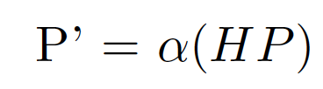
Direct Linear Transform
Find homography H given 4 point correspondences (we need 4 correspondences since H has 8 degrees of freedom)
Start with 1 point correspondence between (x, y, 1) and (x’, y’, 1)

Slide 15
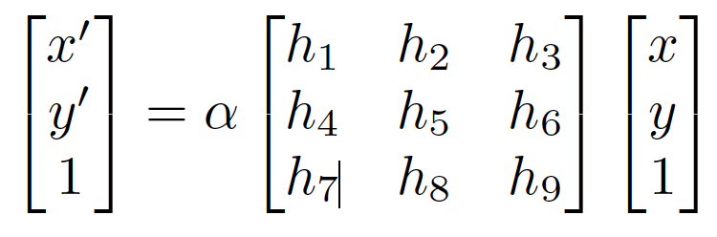
Direct Linear Transform

Slide 16
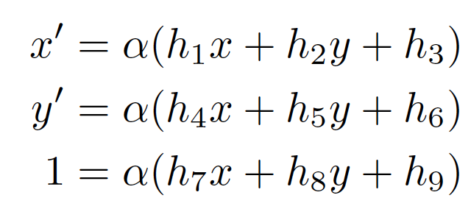
Direct Linear Transform
Multiply out the matrix multiplication

Slide 17
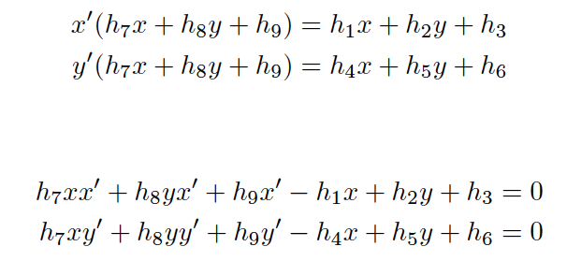
Direct Linear Transform
Divide by alpha, substitute for alpha using third equation, and rearrange terms

Slide 18
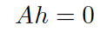
Direct Linear Transform
1 image correspondence is not enough
Use 4 image correspondences by combining 4 sets of equations similar to the last pair on previous slide
Express resulting system using matrix A, where h is a vector of the elements of H
Solve resulting system by SVD on A to find singular vector with singular value of smallest magnitude

Slide 19
RANSAC Motivation
Find correspondences between points in the two images by comparing SIFT feature descriptors
But SIFT is noisy, leading to a lot of false correspondences
We need to filter out the outliers (false correspondences) and use only the inliers (true correspondences)
RANSAC is a method to both find the inliers and fit a model to only the inliers

Slide 20
RANSAC
RANSAC:
Pick inliers randomly
Fit model to inliers
Score model based on number of points fit well; these points are assumed to be inliers
Keep model with largest number of inliers from step 3
Repeat steps 1-4 until some stopping criterion (number of iterations or inliers)
Notes:
The points in space are the correspondences.
Linear model is replaced by H.
And that’s how Ransac works.

Slide 21
RANSAC Example
Say we want to find the center of a dartboard
We have a few points (10% of the total points) close to the dartboard and many points randomly distributed on the dartboard
Model: take average of points selected as inliers
RANSAC in this situation will
Pick inliers randomly
Average the inliers from step a (guess of where center is)
Count number of points close to average from step b
Repeat until some stopping criterion

Slide 22
RANSAC Example
Averaging outliers generally leads to model that does not fit most points well since the other points will generally not be near the average of the outliers (as outliers have no trend)
Then, the model that fits the most points well is the average of the points close to the dartboard (the true inliers)
This point is indeed close to the center and is the model RANSAC will return

Slide 23
RANSAC Assumptions
Generally, RANSAC can be used with small proportion of inliers (for example 10%)
Assumption: outliers don’t have a trend
Hence, model fit to outliers will not fit many points well
Model that fits the most points should be the best and fit well to inliers
Notes:
At least it fits the small number of inliers well - the dart example

Slide 24
RANSAC For Image Correspondence
RANSAC (applied to finding correspondences):
Pick 4 random point correspondences (4 Pairs of points) (from SIFT)
Compute H using DLT
Score H using number of correspondences (from the set of all correspondences) it fits well
Keep H with largest number of inliers from step 3
Repeat steps 1-4 until some stopping criterion (number of iterations or inliers)

Slide 25
Deep Learning
In contrast to most of the prior techniques, which focus on hand-crafted feature extraction (for example, SIFT) or convolution filters to perform a task
We will now try to learn a deep neural network to perform the task from a large dataset of training samples
Some general machine learning concepts first

Slide 26
Problem Setting for Machine Learning
We focus on supervised learning (as opposed to other types of learning) here
Goal: find a function f: X-> Y that maps inputs x ∈ X to labels y ∈ label space Y
Assumptions:
We have a paired dataset {x_{i}, y_{i}}_{N} drawn i.i.d from the joint distribution P(x, y)
Inputs and labels are paired
We do not know the joint distribution P(x, y)

Slide 27
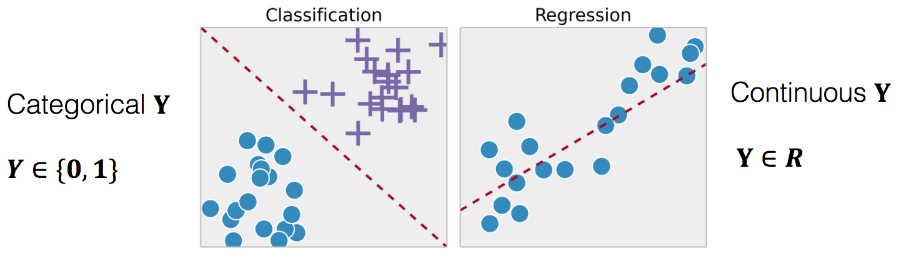
Example Settings
Classification: Y is discrete space or for binary classification, Y∈{0, 1}
Regression: Y is real number

Slide 28
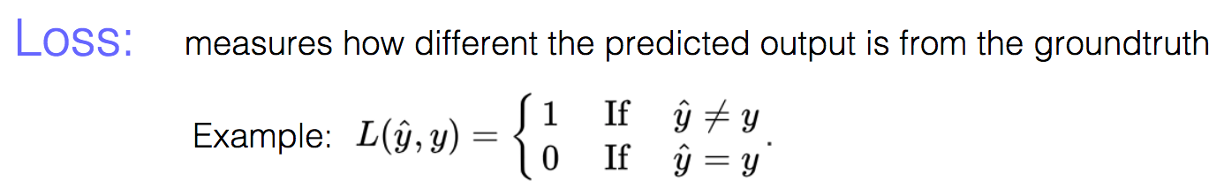
Loss, Risk, Empirical Risk
First question: how do we evaluate how good a model f is?
Ideally, we would minimize some loss over the whole joint distribution p(x, y)
Loss should measure how far away model’s prediction f(x) is from the true label y

Slide 29
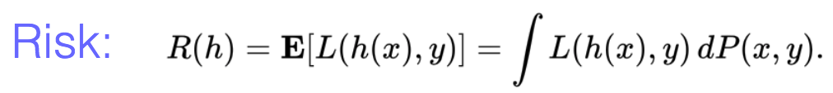
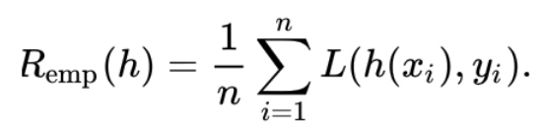
Risk, Empirical Risk
Risk: minimize the expected value of the loss over P(x, y)
There’s a problem with using risk: we don’t know P(x, y), so we can’t compute risk and can’t actually use it as a metric
We approximate risk using empirical risk, i.e. we take some unseen test set (distinct from training and validation sets) and compute the expected loss

Slide 30
Overfitting
Ideally, we could just minimize empirical risk over training set and our model would perform well on test data
Unfortunately, it’s not that simple
Since the training set is finite, the training set’s distribution does not exactly match the true joint distribution P(x, y)
Hence, the model f can fit to noise in the training set (pecularities of the training set that do not appear in the joint distribution)
Since f is now fit (“overfit”) to training set noise, its performance on test data can be significantly worse

Slide 31
Underfitting
On the opposite side, it’s also possible f is too simple of a function to fit the training data well
In this case, train and test error are both high
For underfitting, there are a few solutions:
Train model for longer: it’s possible the training hasn’t converged
Pick a more complex function f that can fit training data better (for example, pick a more complex neural network)

Slide 32
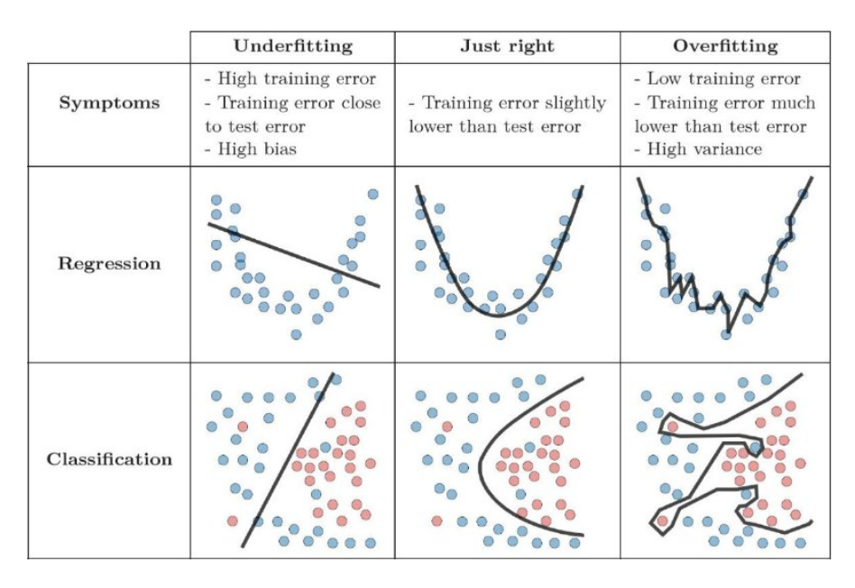
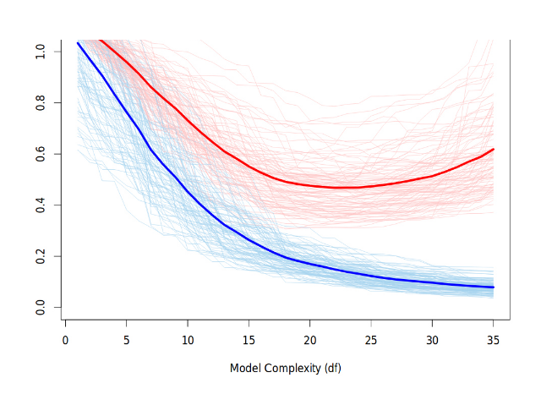
Overfitting vs Underfitting
Overfitting / underfitting is also referred to as a model having high variance / high bias
Blue is training error, red is test error

Slide 33
Fixing Overfitting
Overfitting is a much more complex issue to fix than underfitting, unfortunately
A few ways:
Train for less time so model does not fit training data as well (the amount of training can be determined using error on a validation set, i.e. early stopping)
Regularization (discussed more on next slide)
Dropout (discussed more later)
Data augmentation (apply random transformations to input data during training like shifts, rotations, contrast changes etc. so you don’t overfit to certain factors like orientation or illumination)
A simpler model that can’t fit training data as well (and hopefully, won’t fit to the noise in the training set)

Slide 34
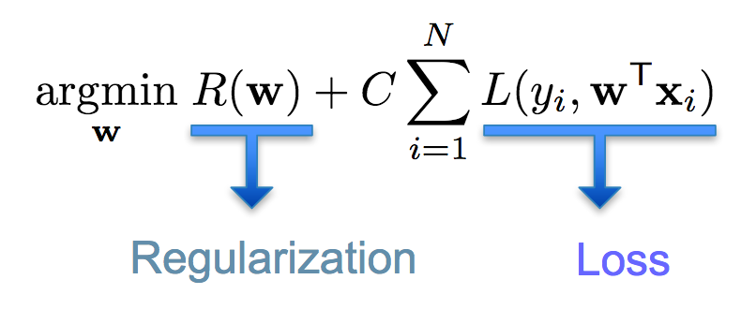
Regularization
Add a loss term so that the model will not fit the training data as well

Slide 35
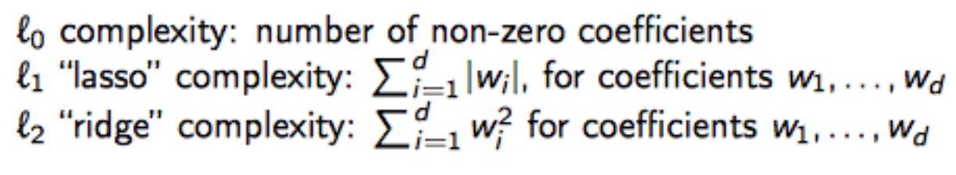
Examples of Regularization
Simplest types of regularization:
l₀: number of weights: not differentiable and generally fixed when training a given model, so not really used
l₁ loss on weights (“lasso”)
l₂ loss on weights (“ridge” or “weight decay”)

Slide 36
Validation, Cross-Validation
In practice, we do not want to use the test set to see whether we are overfitting or not because we will then adjust settings (hyperparameters) in response and fit somewhat to test set
Instead, we can employ one of two options: validation or cross-validation
The simpler option (when we have enough data) is validation
Validation: split the training set into a training set (used to learn the weights) and a validation set (used to evaluate how well model generalizes and to tune hyperparameters)
Only use test set at the very end once we have gotten a final model to measure how well final model will do on unseen data

Slide 37
Tuning Hyperparameters with Validation
We can tune settings of the training process (things like how long to train for, neural network architecture, etc.) which are not the model weights by looking at the loss on the validation set
For example, if we find we are overfitting (train error is significantly greater than validation error), we can choose to train for less time or use a simpler model
Early stopping: instead of picking a fixed amount of iterations to train for and tuning this number, let the validation loss do it for you; once the validation loss stops decreasing, stop training as we are now going to overfit the training set

Slide 38
Cross-validation
If we don’t have much data and don’t want to make our training set even smaller: use cross-validation
Cross-validation:
1. Split data into two parts (one for training, one held-out)
2. Train model on training split
3. Compute error on held-out split
4. Repeat steps 2 and 3 with different splits of overall training set and average the errors from step 3 to get an overall estimate of the error (cross-validation error) on unseen data
Now, we can use cross-validation error in a similar way to validation error to tune hyperparameters

Slide 39
Variants of Cross-Validation
Leave one out cross validation: we have N splits, where N is number of data points; for each split i, we hold out x_{i} (i^{th} data point) and use rest for training
K-fold cross validation: split training data into k folds; we have k splits where for split i, we hold out fold i and use the other folds for training

Slide 40
Example Loss Functions
We’ve mentioned how to compute empirical risk, but this depends on which loss function is picked
The loss function depends on the task, but there are standard losses for classification and regression

Slide 41
Classification Losses
Let y be true label, y’ be estimated label from model
Classification losses
0-1 loss: L(y, y’) = 1 if y = y’, 0 otherwise
this loss is used for evaluation (classification accuracy) but not training since it’s not differentiable and provides no feedback on how far y’ is from y
Hinge loss (used for SVMs, assumes labels are either -1 or 1): L(y, y’) = max(1-y’y, 0)
penalizes misclassification but no reward for classifying “more correctly” (i.e. for increasing y’y past 1)
Log-loss / cross-entropy loss (used for deep learning, for this equation assume labels are either 0 or 1): L(y, y’) = -y log y’ - (1 – y) log (1 – y’)
This loss function comes from information theory; essentially, it encourages p(y’|x) to match p(y|x)

Slide 42
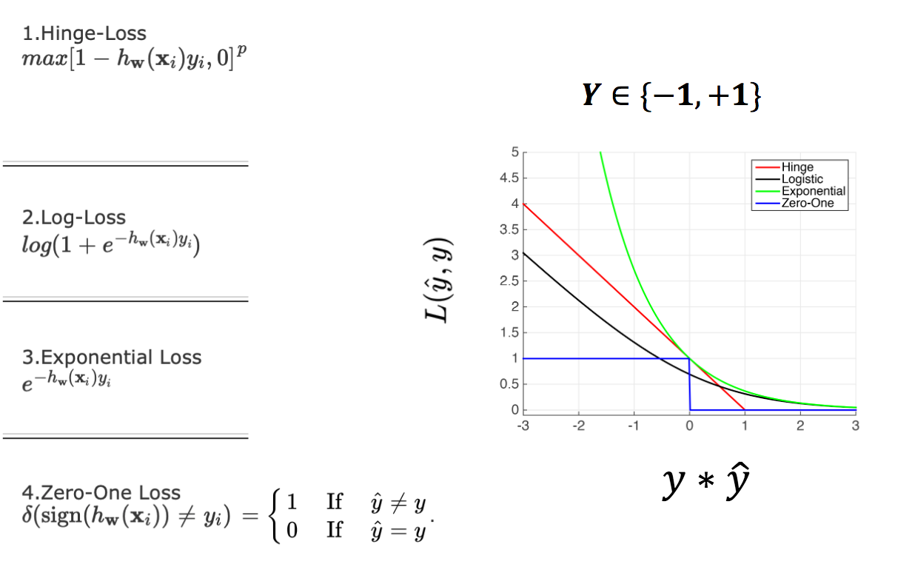
Classification Losses
For this slide, assume labels are -1 or 1

Slide 43
Regression Losses
For regression, most popular loss functions are l₁ and l₂
l₁ loss: L(y, y’) = |y– y’|
This loss penalizes big errors less and encourages exact predictions (since the derivative of the loss stays the same for big and small errors)
l₂ loss: L(y, y’) = (y – y’)²
This loss penalizes big errors a lot but small errors less
Huber loss is a mix of l₁ and l₂ losses in the sense that it acts similar to l₁ loss for small errors and l₂ loss for big errors

Slide 44
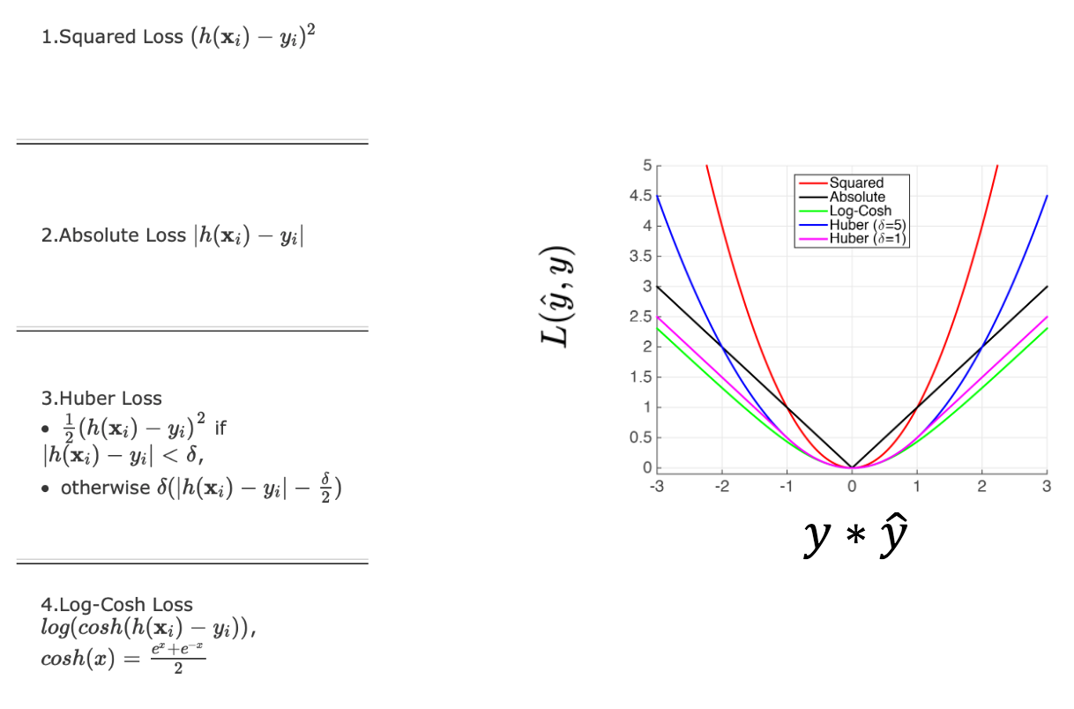
Regression Losses
Note: I think the graph’s x axis is mislabeled: it should be y – yhat, not y * yhat

Slide 45
Overall Machine Learning Pipeline
Step 1: Collect data if you don’t have it and split data into train, validation, test sets (or into train and test sets if using cross-validation)
Step 2: Pick initial hyperparameters (neural network architecture, length of training, batch size, learning rate, etc.) and loss function
Step 3: Train model on training set
Step 4: Evaluate validation error every so often during training to see how it changes during training; if using cross validation, run cross validation instead
Step 5: Using validation/cross-validation error, tune hyperparameters and repeat steps 3 and 4
Step 6: Once you have final model, evaluate on test set to see performance on unseen data

Slide 46
Gradient Descent
How do we actually minimize the loss on the training data?
One way (used for deep learning) is gradient descent
Idea is simple; we can decrease the loss by updating weights in opposite direction of gradient
We repeatedly update weights until convergence

Slide 47
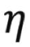
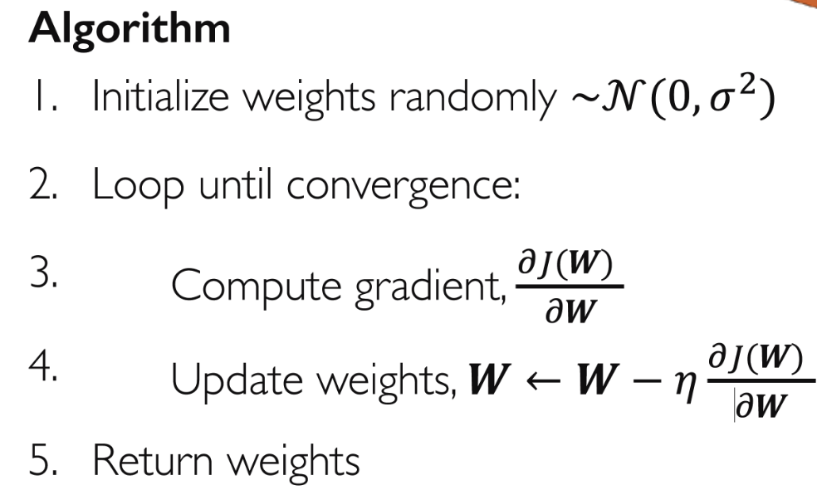
Gradient Descent
Note the important parameter , the learning rate (controls update size)

Slide 48
Computing Gradient
Gradient descent seems simple enough, but there’s one big question: how to compute the gradient?
Two methods: numerical approximation and analytical
Numerical approximation works better if you’re ok with an approximation or if your gradient is not easily computable analytically
Analytical gradient is used for deep learning since a neural network consists of matrix multiplication / convolutions and simple nonlinearities whose gradients can be computed analytically

Slide 49
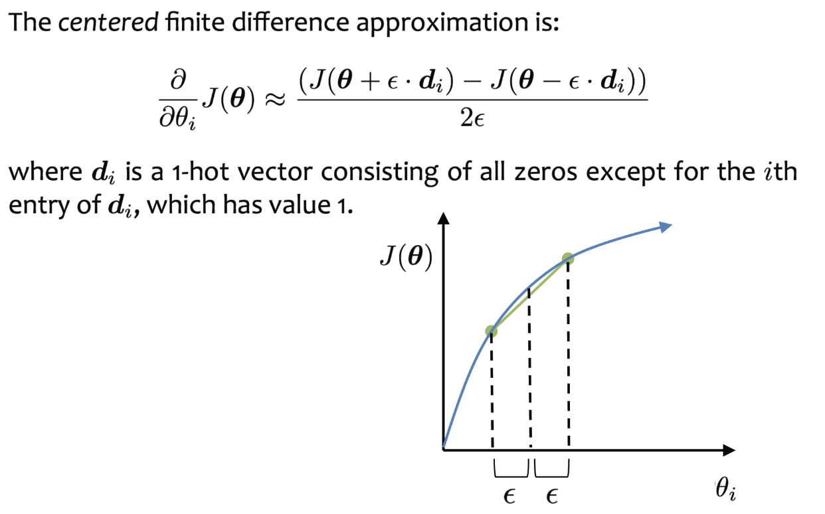
Numerical Approximation
Use finite difference to approximate partial derivative

Slide 50
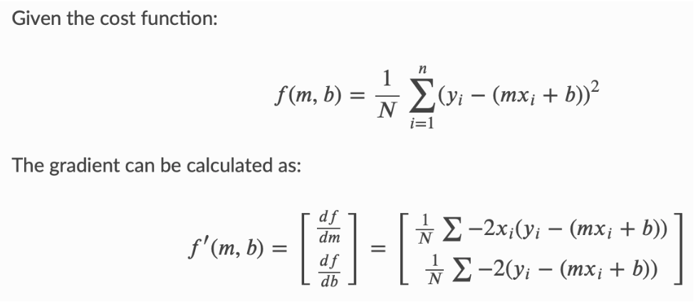
Analytical Gradient
Use functional form to compute gradient exactly via calculus

Slide 51
Batch, stochastic, mini-batch GD
(Batch) gradient descent requires you to compute loss over every sample in training set before updating the weights -> slow to update weights
To fix this slow update issue, we can use stochastic gradient descent (batch size = 1): just compute loss over a randomly selected sample before updating weights; however, updates are very noisy as they depend on a single sample
Let’s get best of both worlds: mini-batch gradient descent (with some fixed batch size): compute loss over a randomly selected batch of samples before updating weights

Slide 52
Tricks with Gradient Descent
To improve the optimization process, there have been many optimizers that incorporate various strategies (momentum for example) to improve the convergence
Variants: SGD with momentum, Adam (most popular optimizer), RMSProp, Adagrad, etc.
Another trick that helps is decreasing the learning rate over time
The idea here is that initially, the weights are far away from optimal so we want big updates
Near end of training, weights are close to optimal so we want small updates

Slide 53
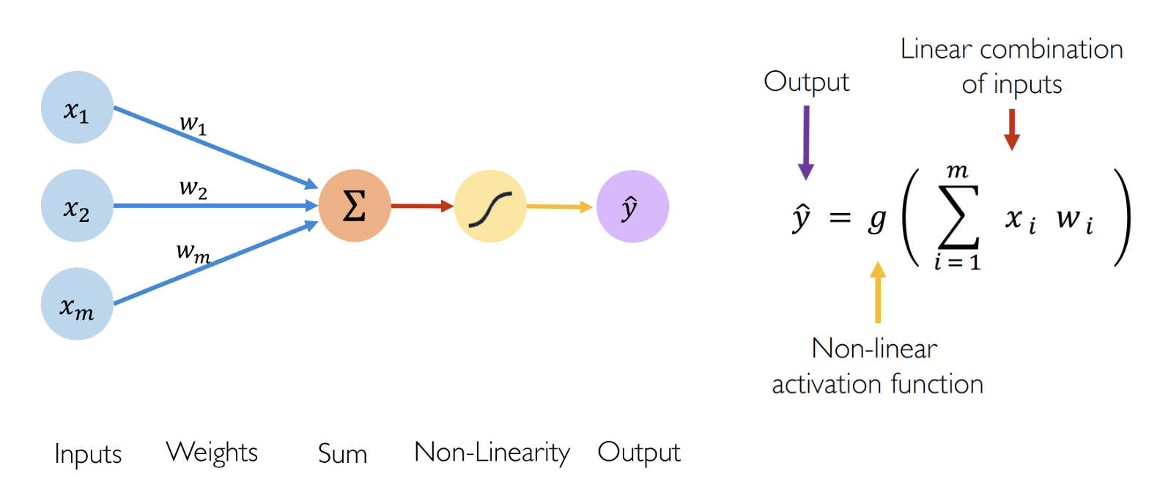
Neural Network Unit (Perceptron)
Simplest neural network unit is perceptron
Take linear combination of weights and inputs and apply a nonlinearity

Slide 54
Example Nonlinearities
Many non-linearities can be used
Popular ones are
ReLU: max(0, x)
Sigmoid (as final activation to output class probabilities for binary classification): 1/(1+e^{-x})
Leaky ReLU: max(x, cx) for some c<1 (often c = 0.1)
Many other non-linearities besides ones listed here

Slide 55
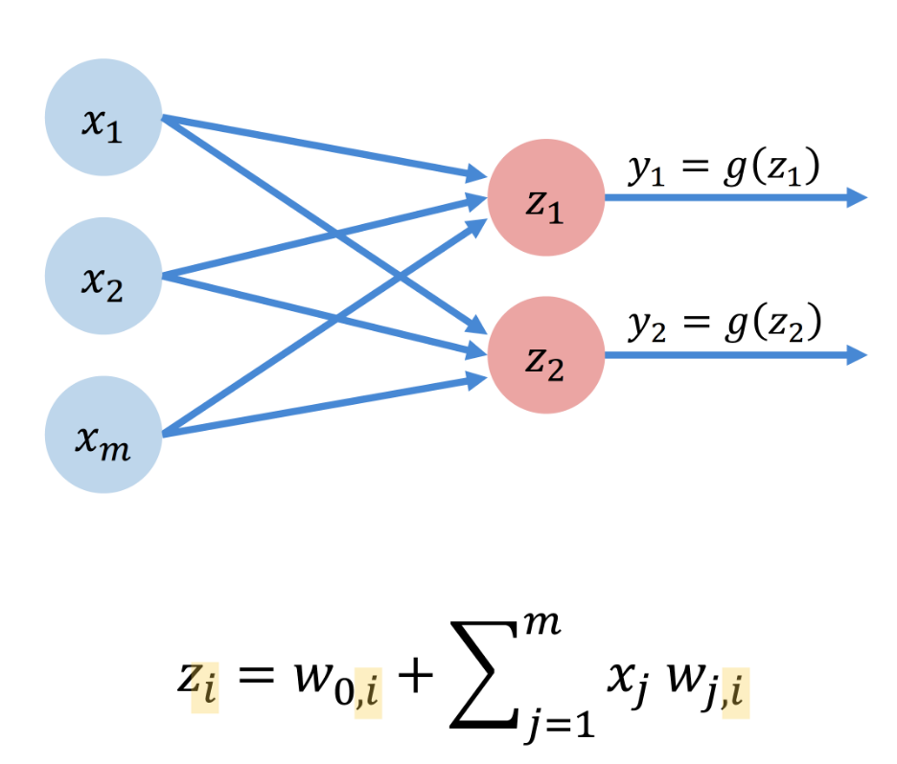
Neural Network Layer
One layer of a neural network can have multiple neurons, each with their own weights and output

Slide 56
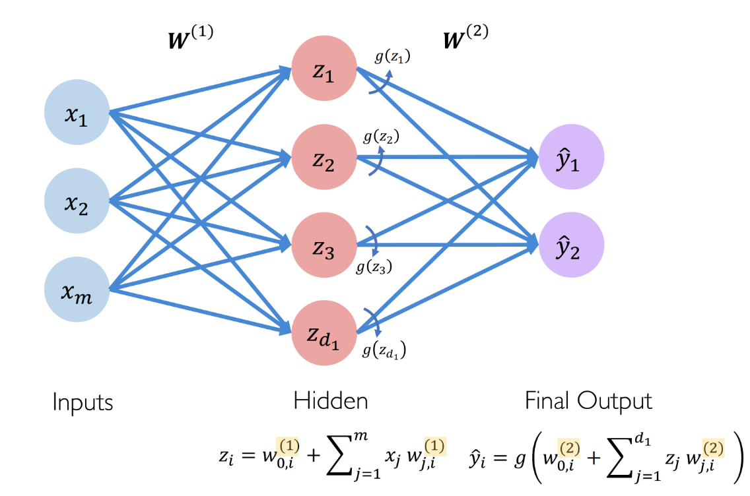
Fully Connected Neural Network
A neural network can have multiple layers, where output of one layer becomes input of the next layer
Can also output a vector (i.e. multiple outputs)
Simple 2-layer neural network below

Slide 57
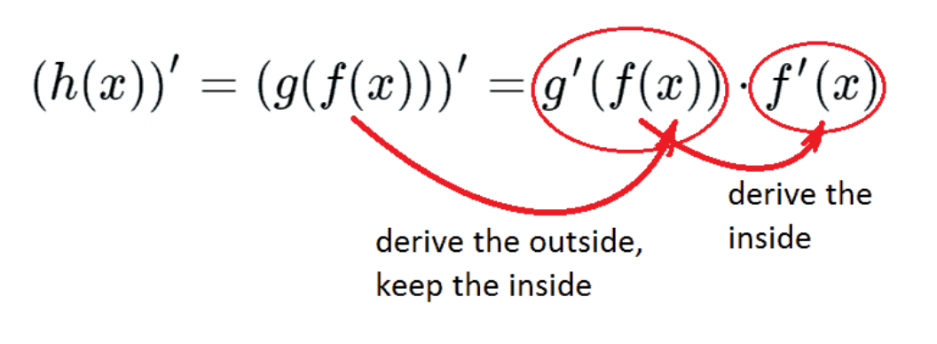
Backpropagation
Running a neural network forward from input to output is simple enough
But how do we compute the gradient for gradient descent?
An efficient way to do this is backpropagation
Backpropagation is based on repeatedly applying the chain rule:

Slide 58
Backpropagation
Compute gradient using chain rule backwards through the weights of each layer
We note that many terms repeatedly come up; we can store computation of individual gradient terms to avoid recomputation

Slide 59
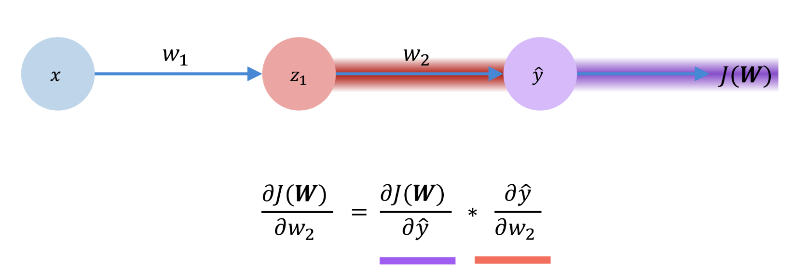
Backpropagation

Slide 60
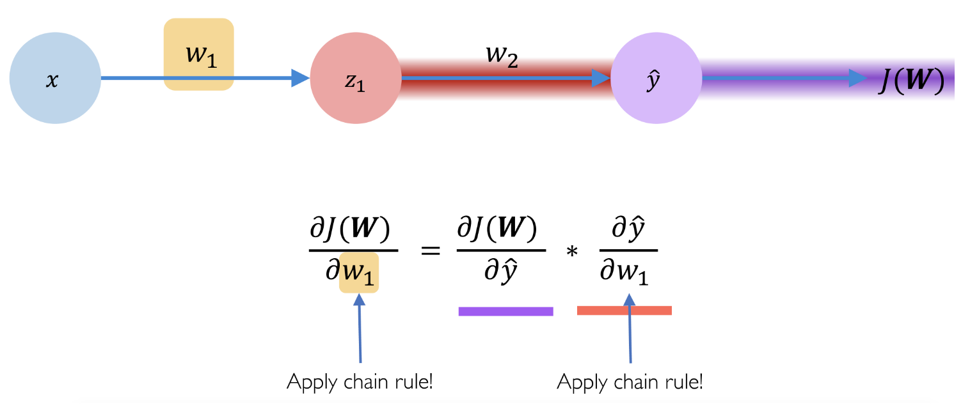
Backpropagation

Slide 61
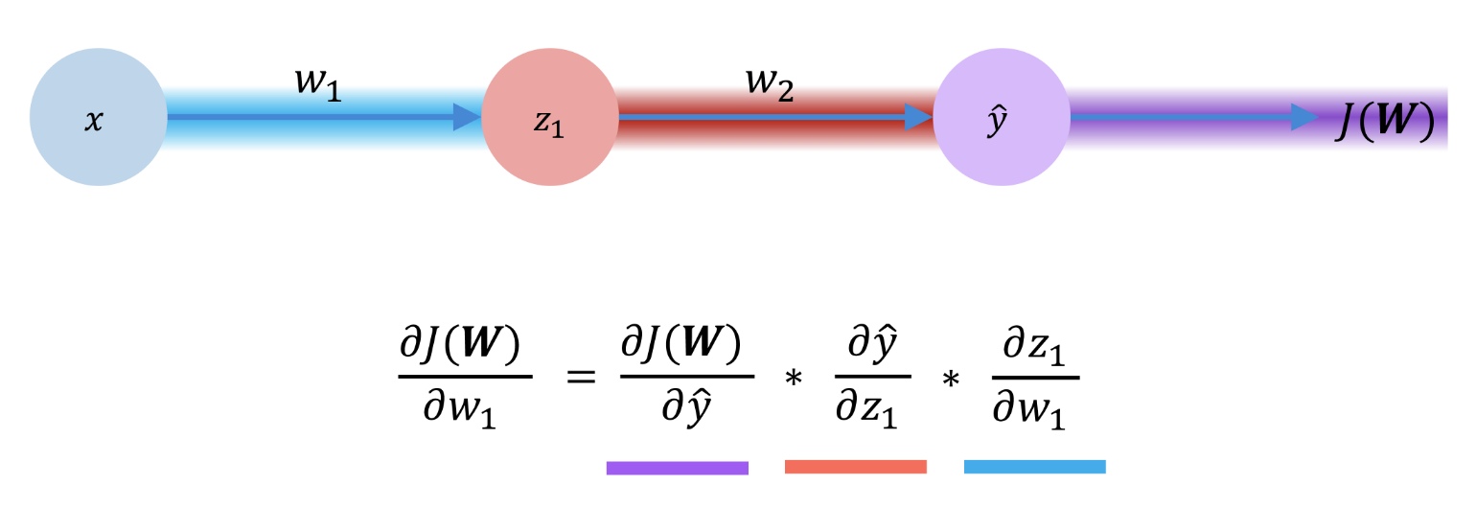
Backpropagation

Slide 62
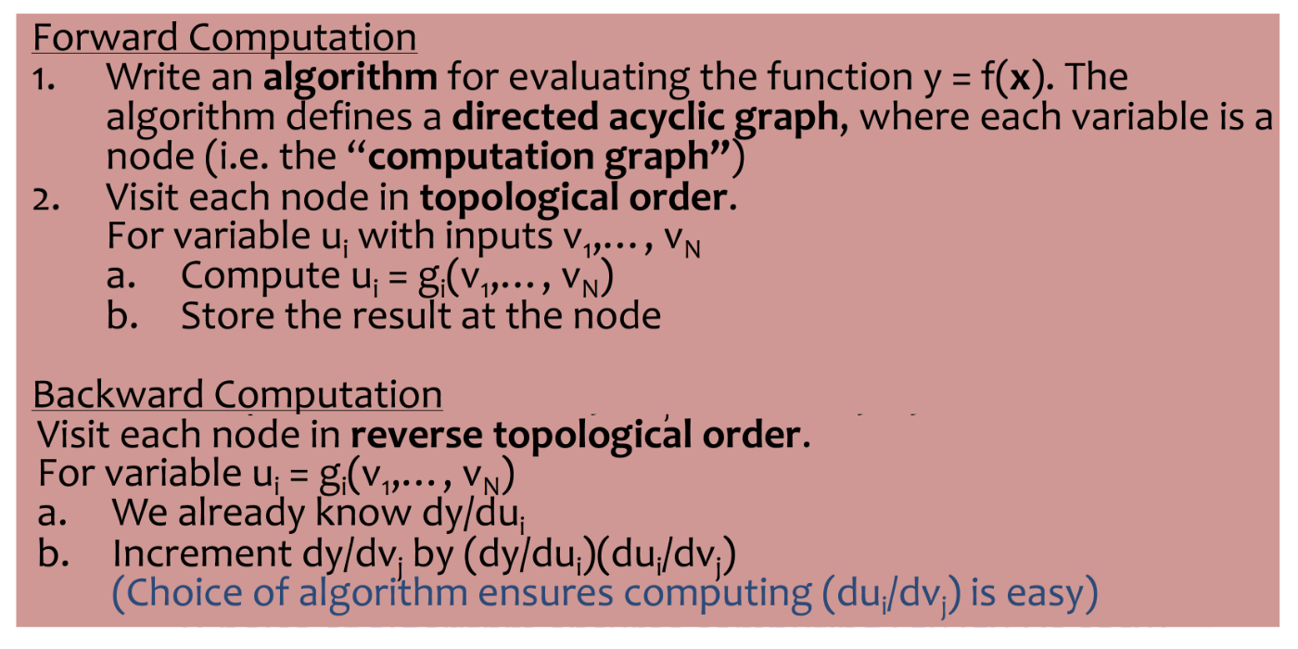
Forward Pass and Backpropagation

Slide 63
Convolutional Neural Networks
So far, we have just assumed neural networks have fully connected layers
However, in computer vision, we generally use convolutional neural networks
Why? Convolutions can be used to extract useful features from images and give translation invariance (i.e. features are extracted from each part of the image in the same way)
By exploiting translation invariance, we can reduce the number of parameters substantially (just need parameters for the convolution filters)
Also, since images tend to have many elements (N^2 for an N x N images), the number of parameters for a fully connected network would explode

Slide 64
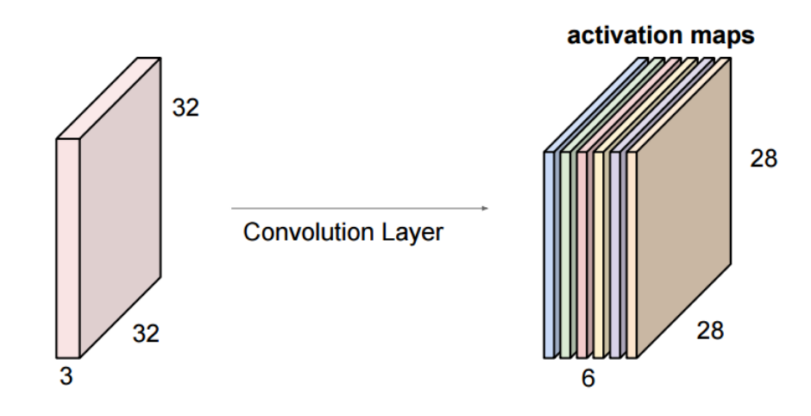
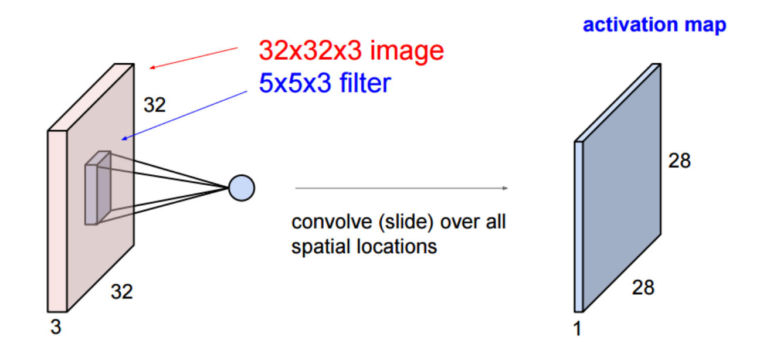
Convolutional Layer
A convolutional layer consists of multiple convolutional filters
To run a convolutional layer, apply convolutions with each filter to the input and then stack the convolution outputs
Note that now convolutional filters can have a depth to process the multiple channels of the input (so it’s like a 3D convolution)

Slide 65
Parameters of Convolutional Layer
Convolutional layers are parametrized by
height and width (of the convolutional filters, which are typically square), depth (how many channels filter should process, typically all of the input channels),
number of filters (number of output channels),
stride (when you take the convolution, you can move the filter by more than one element at a time)
Padding
Activation function

Slide 66
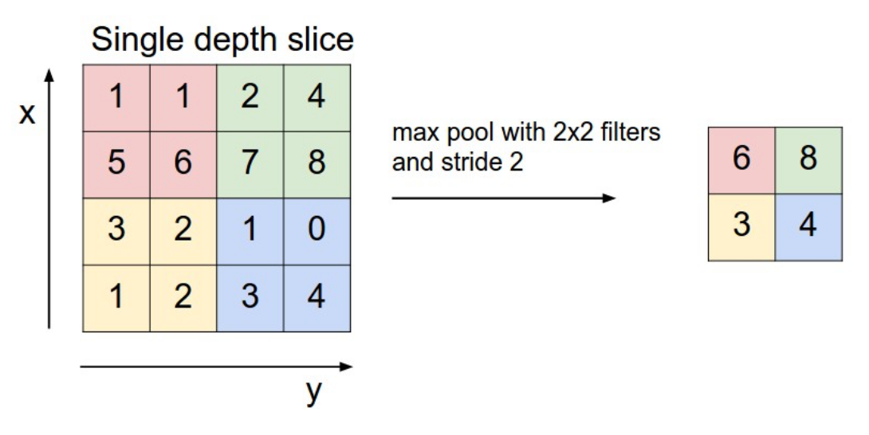
Pooling Layer
Typically, pooling layer is max-pooling (since average pooling is linear and could be learned and as average pooling will blur the max response)
Move 2D window around based on stride and take max (average for average pooling) of elements inside window
Do this for every channel and concatenate the outputs channel-wise
Can also have padding

Slide 67
Dropout Layer
Dropout is a way to prevent overfitting
The idea is during training, we randomly set input units to the dropout layer to 0
Parameter: probability of setting an input unit to 0
This helps prevent overfitting because during training, you can’t depend too much on any particular input unit since it might be dropped out

Slide 68
Flatten Layer
Flattens the input to a lower number of dimensions (typically 1)
If we want to take some 2D features (output from convolutional layers for example) and then make it into a vector and apply FC layers (say for classification), flatten layer is helpful

Slide 69
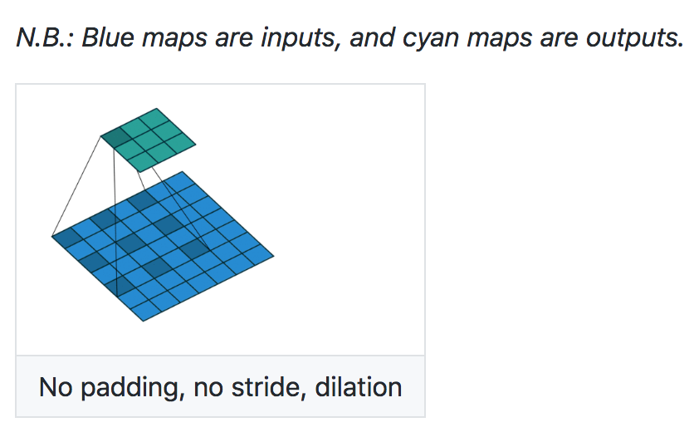
Dilated Convolution
Perform convolution with a dilated filter
Convolution filter’s size is expanded by a certain factor with empty positions filled by 0
This way, each element of the convolution output is influenced by elements farther apart in the input (so receptive size is greater) but number of parameters is the same
See this link for animations of convolution, transposed convolution, dilated convolution: https://github.com/vdumoulin/conv_arithmetic

Slide 70
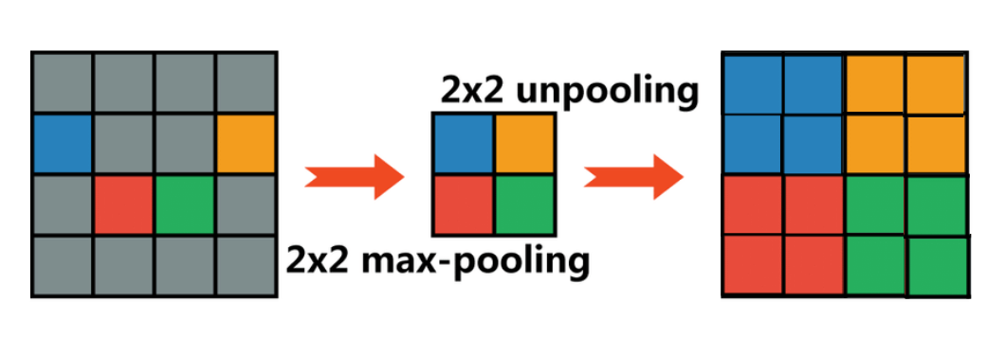
Unpooling
Let’s say we want to “reverse” the pooling process in a way (unpooling is not a true inverse since pooling is not invertible)
We then get unpooling layers
Two ways: nearest neighbor unpooling and max unpooling
Nearest neighbor unpooling: expand the size of the input by a certain factor; elements in output get value of the corresponding input value

Slide 71
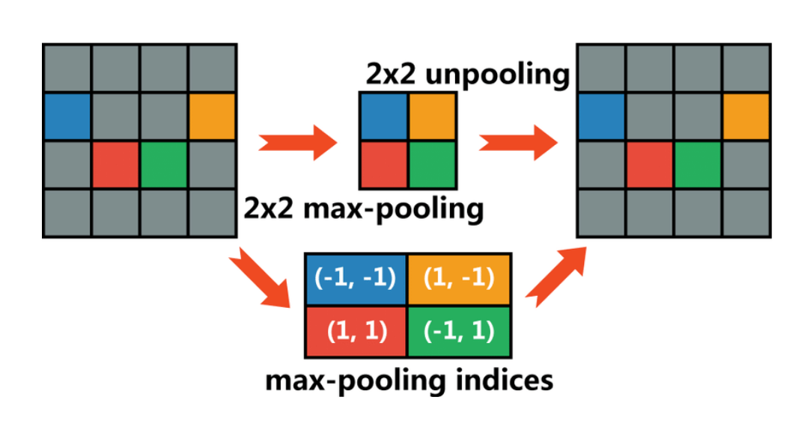
Max Unpooling
Max unpooling: use indices of the maximum from max pooling and set the elements corresponding to these indices in the output to the max values before the max pooling

Slide 72
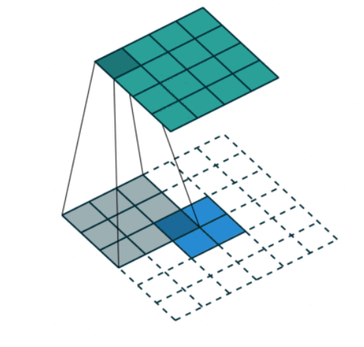
Transposed Convolution
Also called deconvolution, which is a misnomer in the sense that convolutions are generally not invertible
Used to upsample the input
Essentially, take a convolution filter larger than the input, pad input with 0s (for the elements where convolution filter does not overlap with input), and then perform convolution
Again: take a look at this: https://github.com/vdumoulin/conv_arithmetic
Additionally, convolution and deconvolution can be seen as matrix multiplication (check the lecture 14 slides for this)

Slide 73
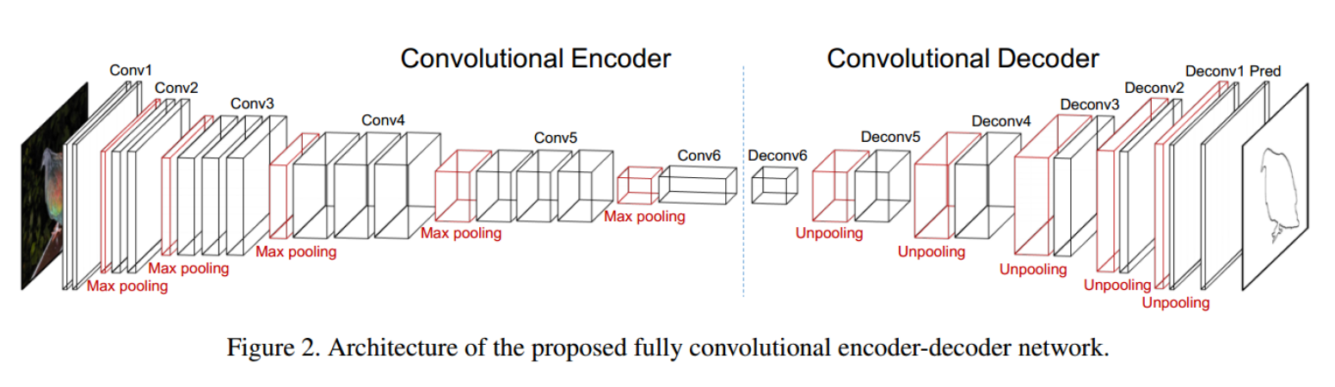
Convolutional Encoder-Decoder
Essentially part of the network (encoder) transforms the input image into some representation using convolutional layers, pooling layers, etc.; other part (decoder) expands representation into output using transposed conv layers
Useful for tasks involving pixel-wise prediction (semantic segmentation for example)

Slide 74
Vanishing Gradient
One issue with deep learning is the vanishing gradient issue
With activation functions like sigmoid (since the gradient is often very small), after backpropagating through many layers, the gradient becomes very close to 0 and the weights of early layers essentially are not updated
One solution: ReLU (since the gradient of positive inputs is 1)
However, if the inputs ever become negative, the corresponding gradients die since ReLU has 0 gradient for negative inputs
Hence, LeakyReLU – instead of returning 0 for negative inputs, return c*x for some c < 1 (often c = 0.1)

Slide 75
Batch Normalization
Another way to solve this issue is batch normalization
Batch normalization tries to keep the distribution of the inputs to each layer more similar (addresses “covariate shift” between layers) by normalizing the inputs during training by a mini-batch mean and variance
At test time, normalize by a moving mean and variance based on the mini-batch means and variances
The normalization essentially makes sure the inputs to convolutional layers have a reasonable scale so the gradients will have reasonable scale

Slide 76
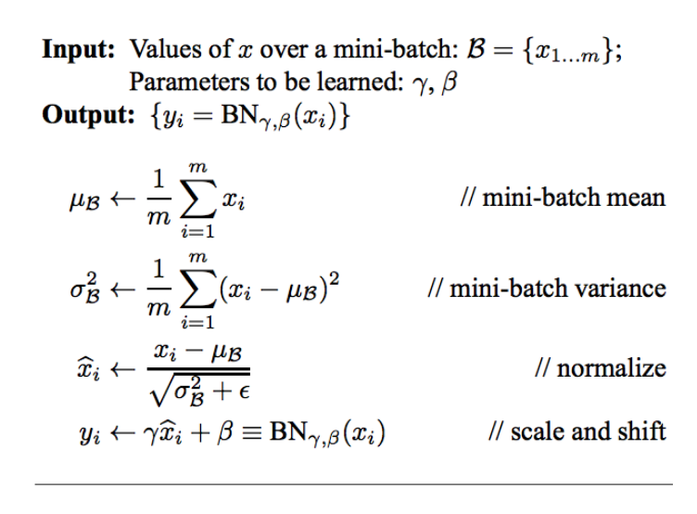
Batch Normalization
Batch normalization is key to training deep networks and avoiding the vanishing gradient issue

Slide 77
Residual Networks
See the homework for details on identity and convolution blocks
The key for why residual connections help with training very deep networks is that residual connections again help address the vanishing gradient issue since now an input from an earlier layer directly influences the output of some deeper layer
Another way to think about it is the information from an earlier layer is propagated through the residual connection to a later layer

